Slide 1
Supplement: Person Re-ID
Hao Luo
2017/4/28

Slide 2
Content
Person Re-Identification Using CNN Features Learned from Combination of Attributes (ICLR2016)
Improving Person Re-identification by Attribute and Identity Learning (L Zheng)
Person Re-Identification by Multi-Channel Parts-Based CNN with ImprovedTriplet Loss Function (CVPR2016)
Beyond triplet loss: a deep quadruplet network for person re-identification (CVPR2017)
Person Search with Natural Language Description (Sensetime)
Video-based Person Re-identification with Accumulative Motion Context (颜水成)
Unlabeled Samples Generated by GAN Improve the Person Re-identification Baseline in vitro
Pose Invariant Embedding for Deep Person Re-identification
SVDNet for Pedestrian Retrieval
Re-ranking Person Re-identification with k-reciprocal Encoding (CVPR2017)

Slide 3
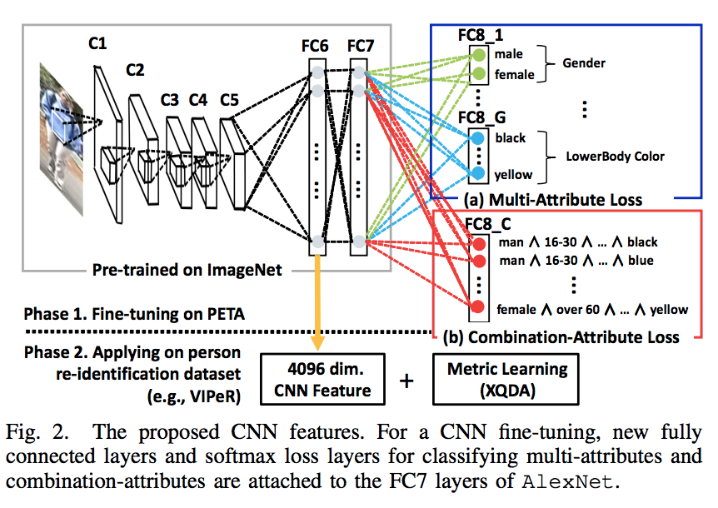
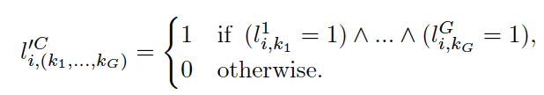
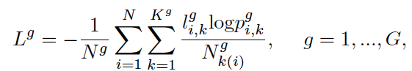
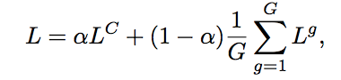
Person Re-Identification Using CNN Features Learned from Combination of Attributes (ICLR2016)
Full label
Attributes label loss
Loss
Top1
VIPeR:46.3%
CUHK01:49.9%
PRID450S:56.5%
GRID:24.3%

Slide 4
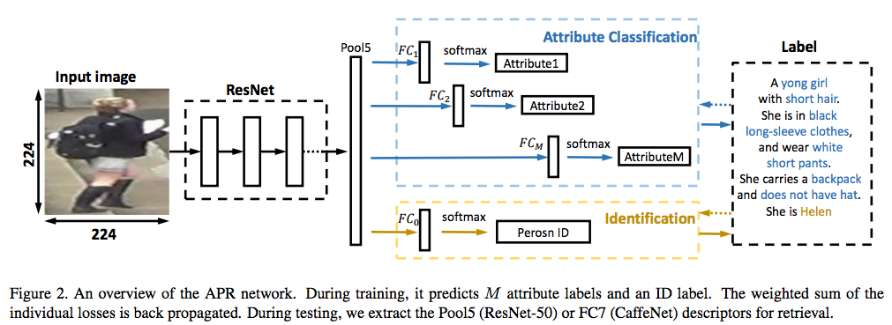
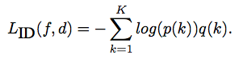
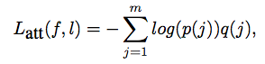
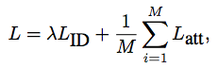
Improving Person Re-identification by Attribute and Identity Learning (L Zheng)
ID Loss
Attributes Loss
Final Loss
Top1:
Market1501: 84.29%
DukeMTMC-reID: 70.69

Slide 5
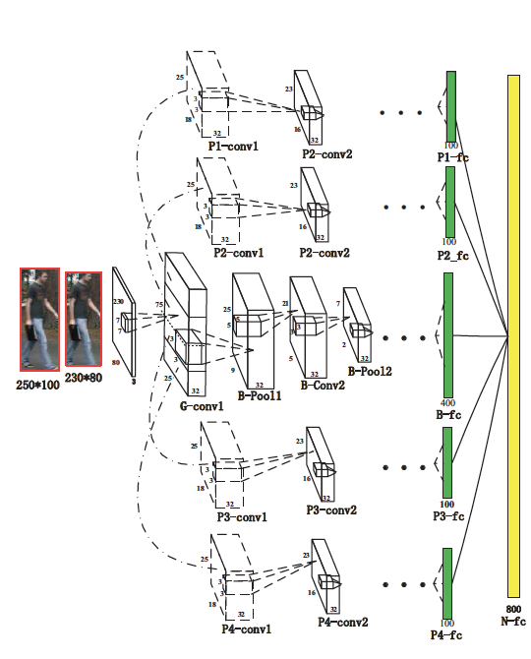
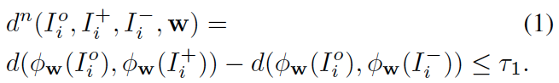
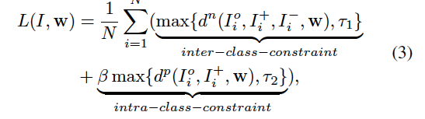
Person Re-Identification by Multi-Channel Parts-Based CNN with Improved Triplet Loss Function (CVPR2016）
Inter-class-constraint
Intar-class-constraint
Improved triplet loss function
Top1
VIPeR:47.8%
i-LIDS:60.4%
PRID2011:22.0%
CUHK:53.7%

Slide 6
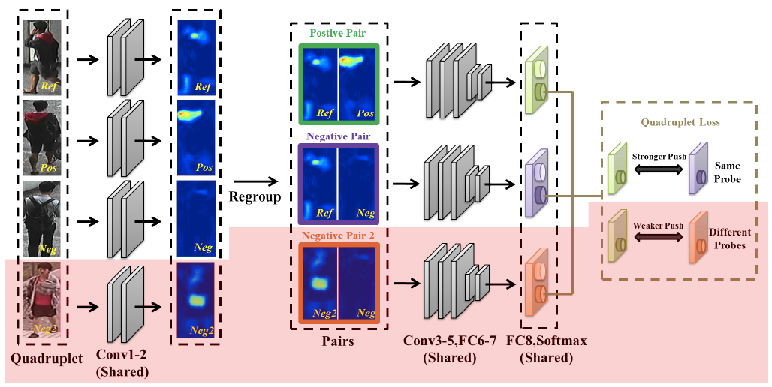
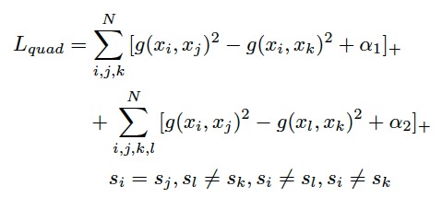
Beyond triplet loss: a deep quadruplet network for person re-identification (CVPR2017)
Quadruplet loss
i: Ref j: Pos
k: Neg1 l: Neg2
Top1
VIPeR:49.05%
CUHK01:62.55%
CUHK03:74.47%
Quintuplet: Ref1 Pos1 Neg Pos2 Ref2
Pos2 is Neg2 for Ref1; Pos1 is Neg2 for Ref2

Slide 7
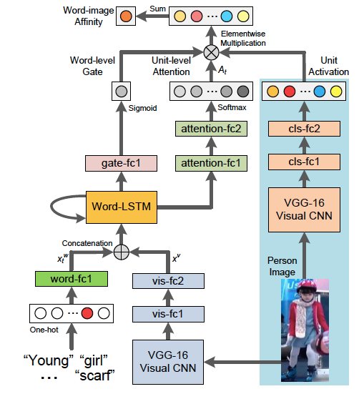
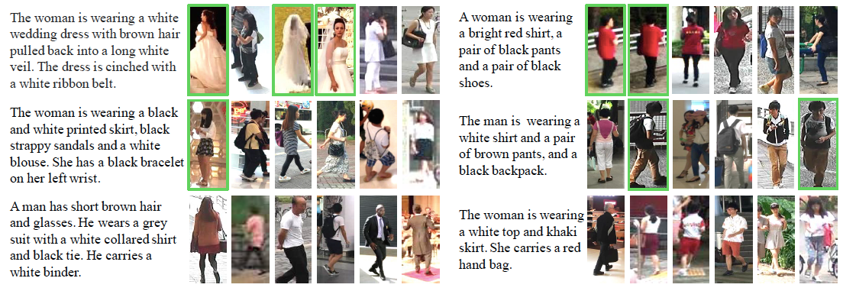
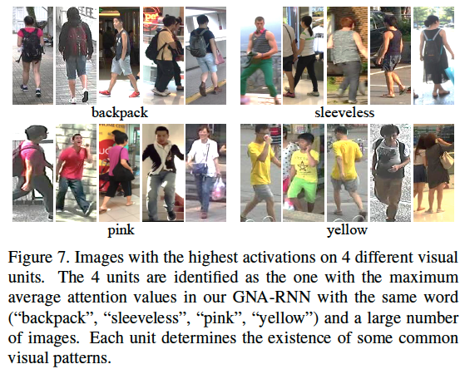
Person Search with Natural Language Description (Sensetime)

Slide 8
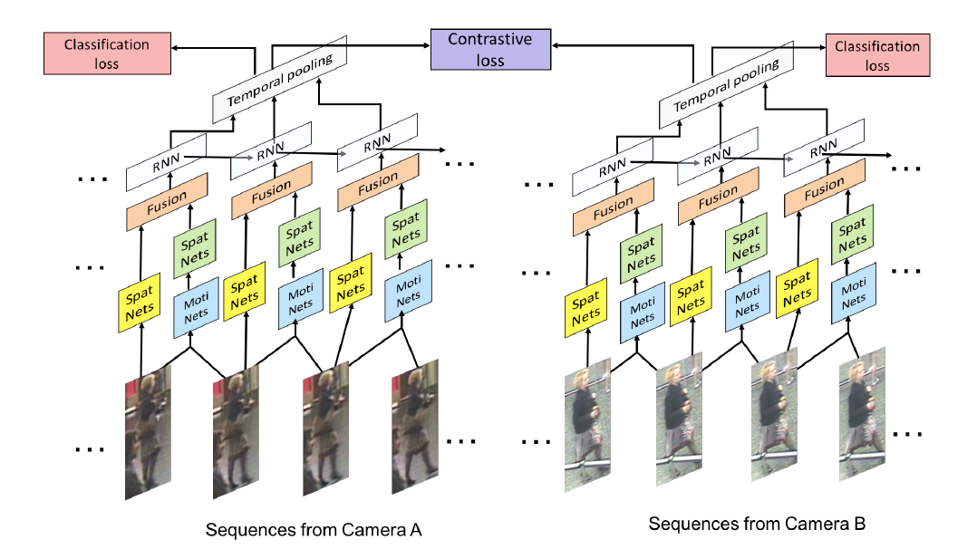
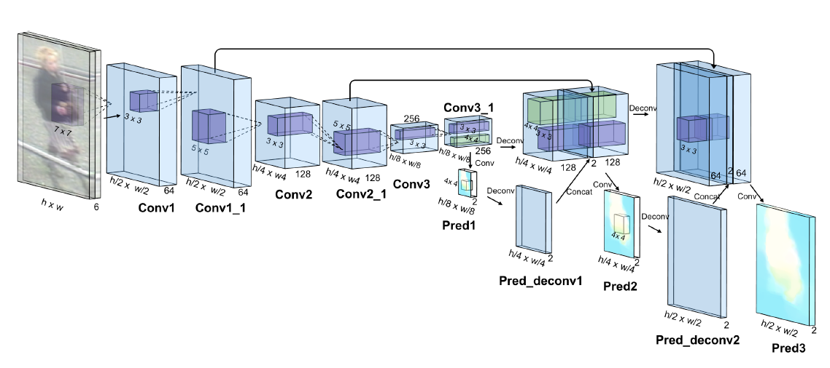
Video-based Person Re-identification with Accumulative Motion Context (颜水成)
Moti Nets: Flownet
Spat Nets: 3 layers CNN
Fusion: Concatenation fusion
Loss: Contrastive&Classification loss
Data: Crop&Mirror
Top1
PRID2011:83.7%
iLIDS-VID:68.7%

Slide 9
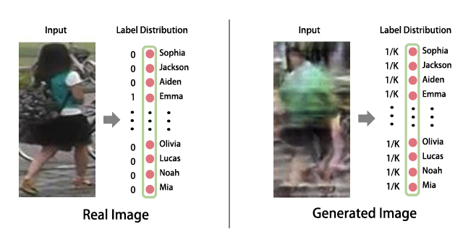
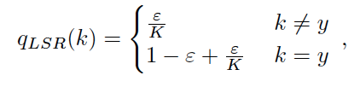
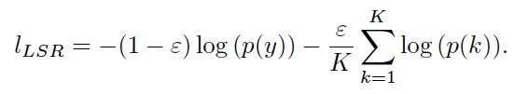
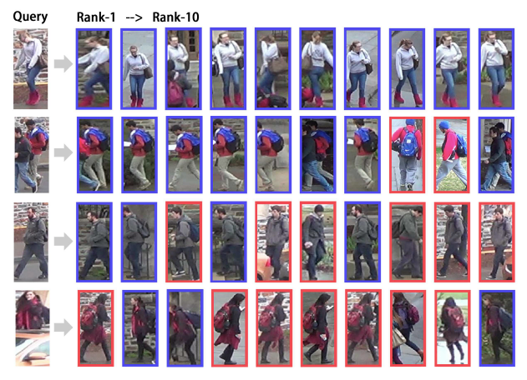
Unlabeled Samples Generated by GAN Improve the Person Re-identification Baseline in vitro
LSRO
Top1(self-network)
Market1501:78.06%
CUHK:73.1%
Top1(public network)
Market1501:83.97%
CUHK:84.6%

Slide 10
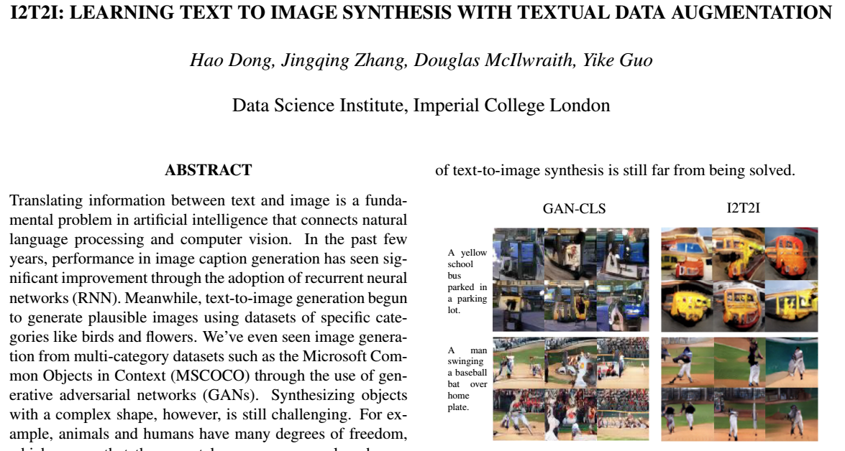
Unlabeled Samples Generated by GAN Improve the Person Re-identification Baseline in vitro

Slide 11
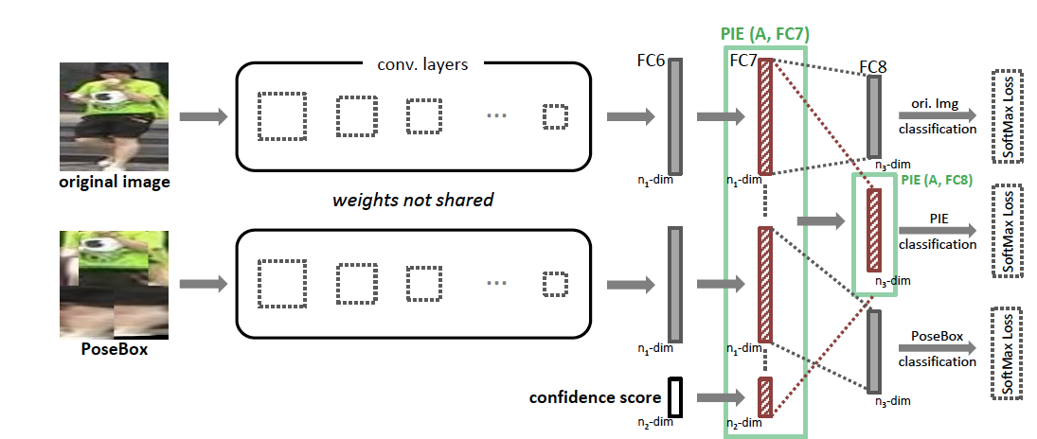
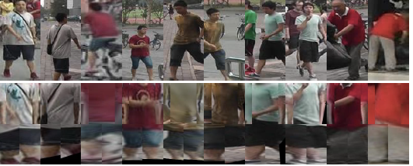
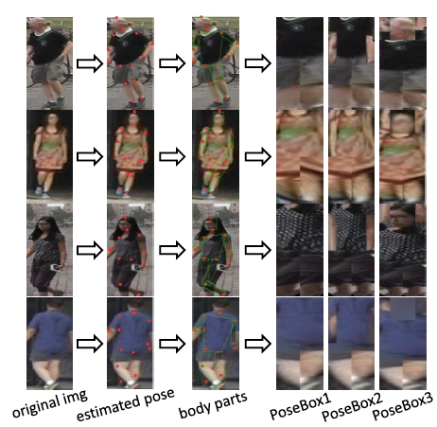
Pose Invariant Embedding for Deep Person Re-identification
Top1
Market1501:79.33%
CUHK:67.1%
VIPeR:54.49%
Pose: CPM network
Landmark: 14 points
Affine transformation: preprocessing

Slide 12
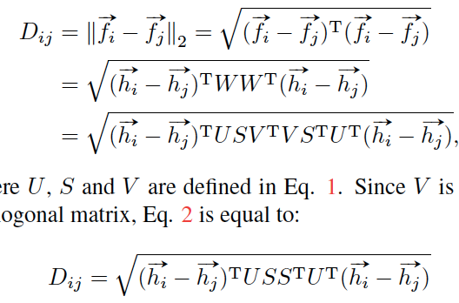
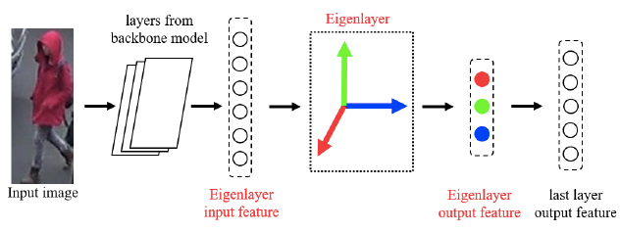
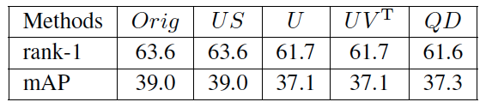
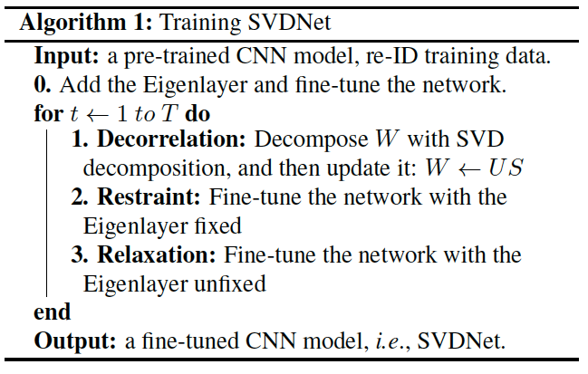
SVDNet for Pedestrian Retrieval
Just fine-tuning
No accelerate
Top1
Market1501:82.3%
CUHK:81.8%
DukeMTMC-reID:76.7%
Accelerate: network architecture changed ?

Slide 13
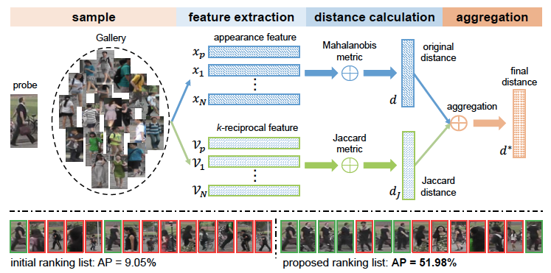
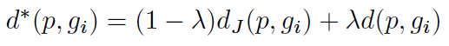
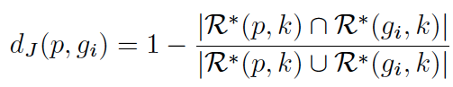
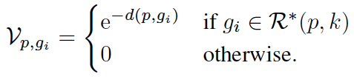
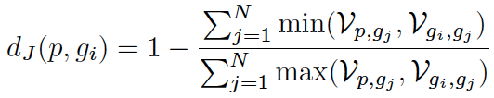
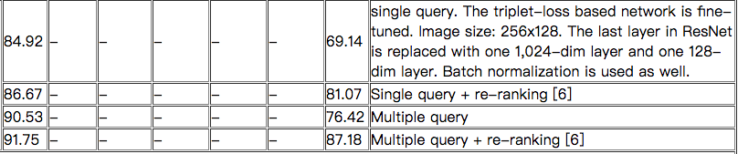
Re-ranking Person Re-identification with k-reciprocal Encoding (CVPR2017)
Dis = Maha Dis + Jaccard Dis
Jaccard distance: sets similarity
Top1
Market1501:77.11%
Mars:73.94%
PRW:52.54%
http://www.liangzheng.org/Project/state_of_the_art_market1501.html

